Slide 1
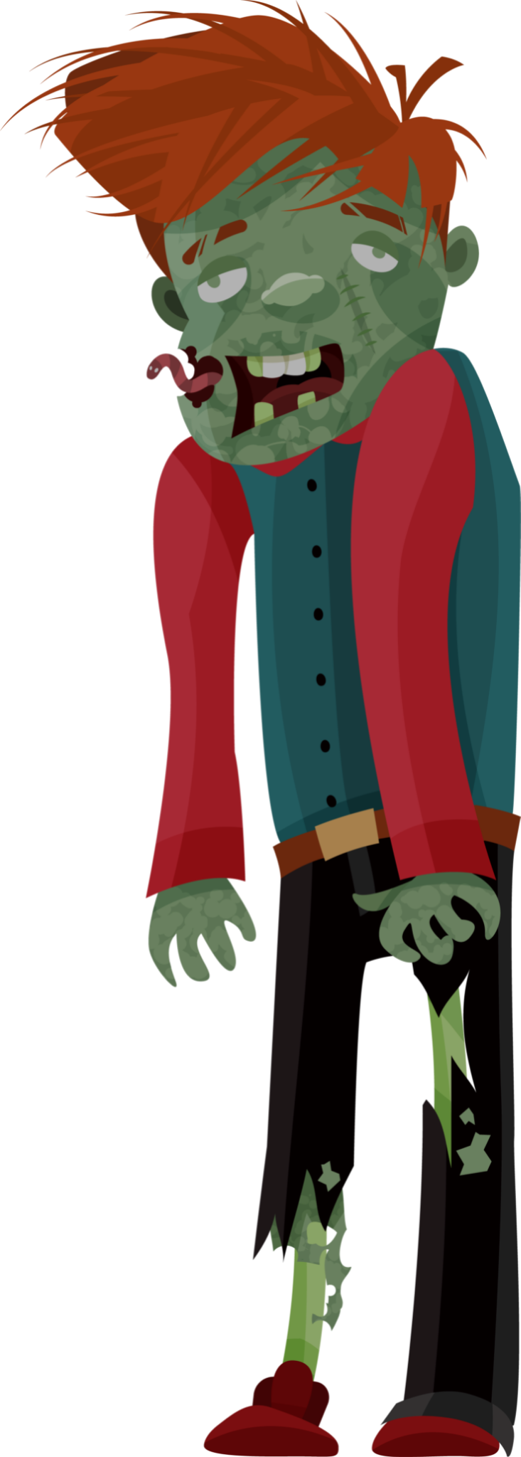
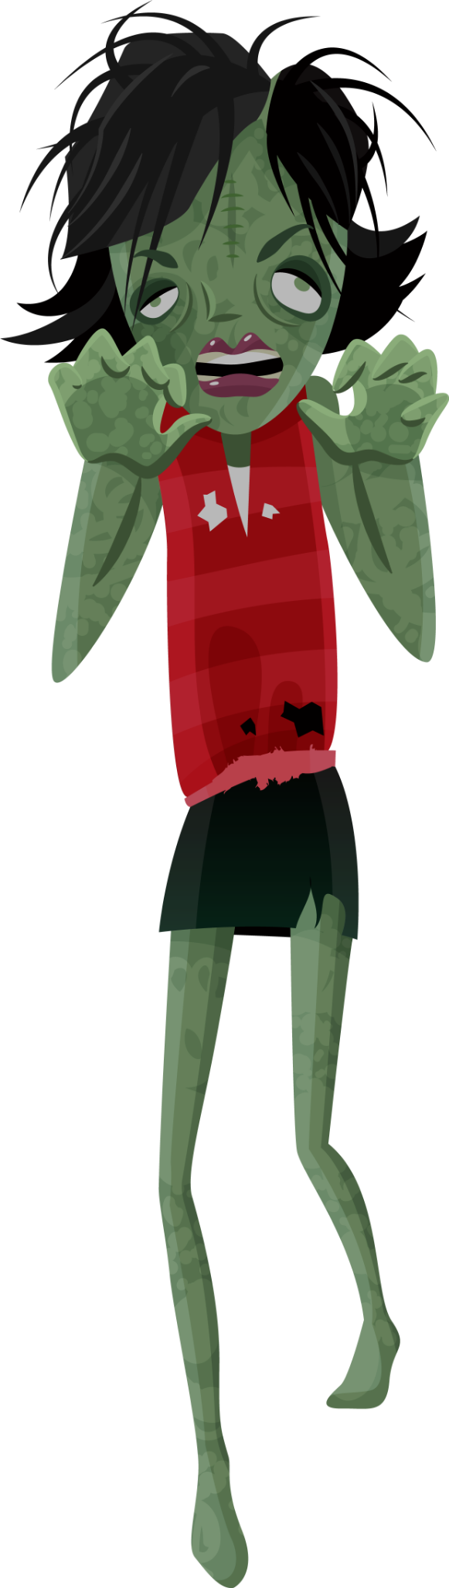
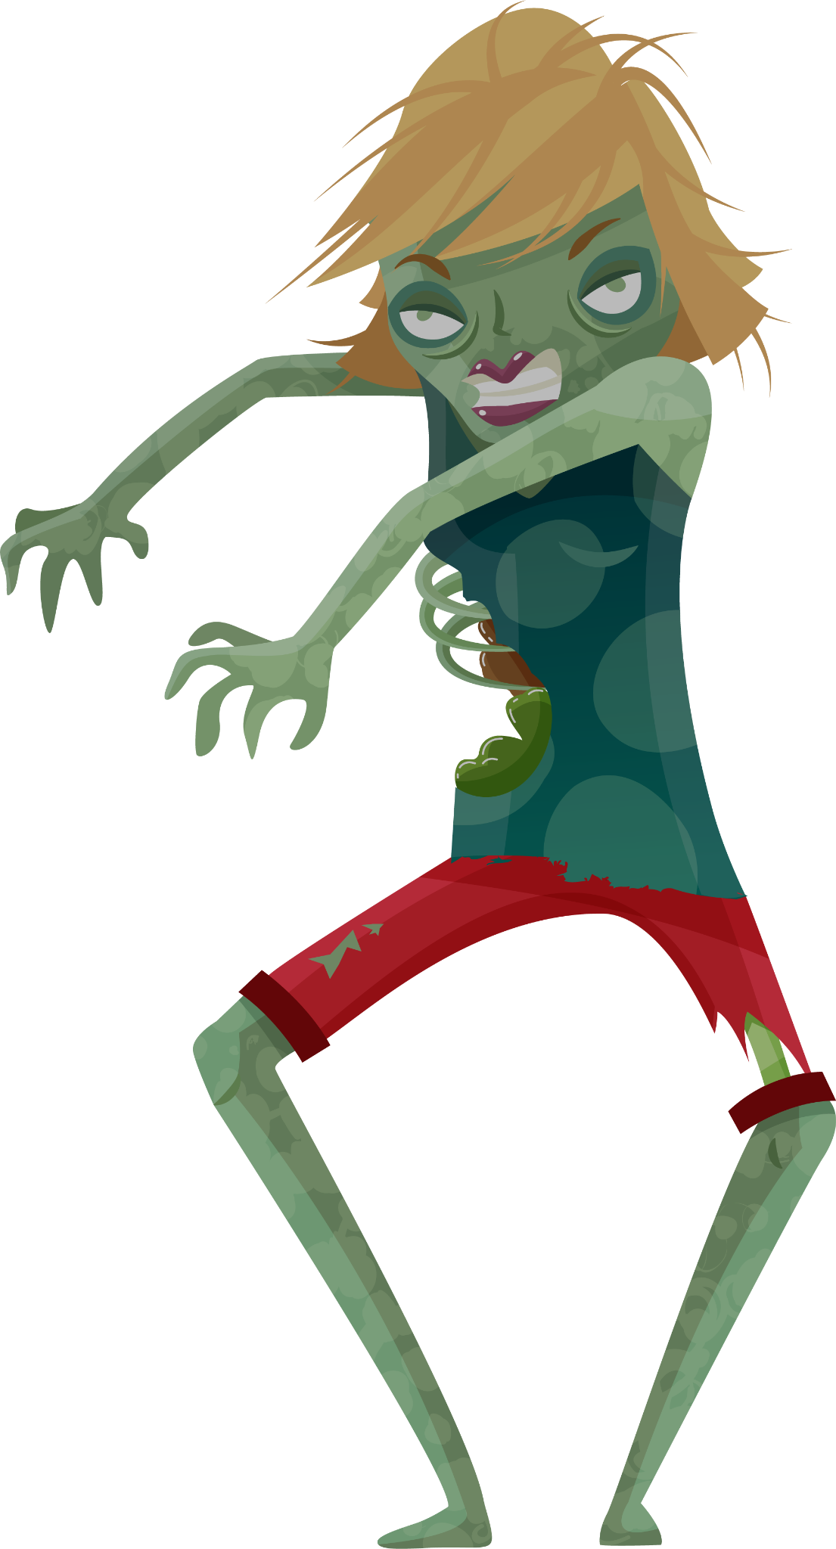
Plants vs. Zombies in java
A Showcase of Fun Gameplay and Innovative Design

Slide 2
1 Billion+ users
20+ languages
150+ countries
A Global Gaming Phenomenon
Home
sun
Plants
score
level

Slide 3
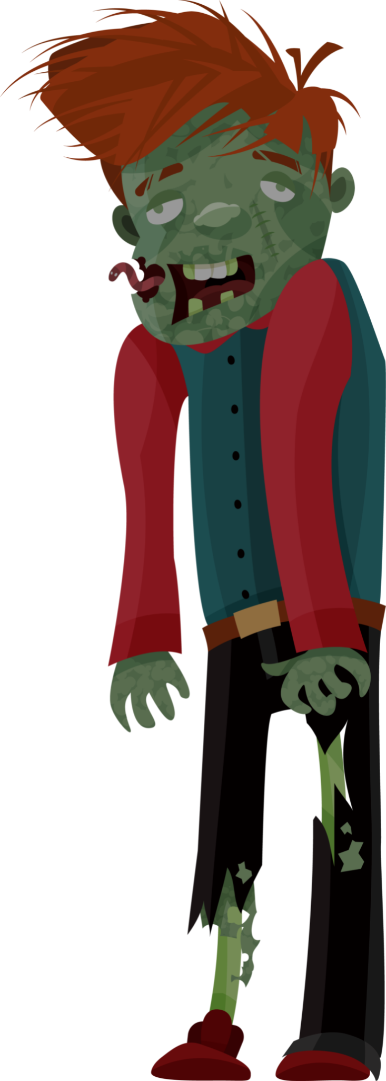
Demo &
Technical
implementation
01

Slide 4
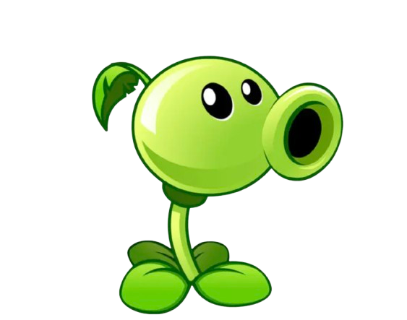
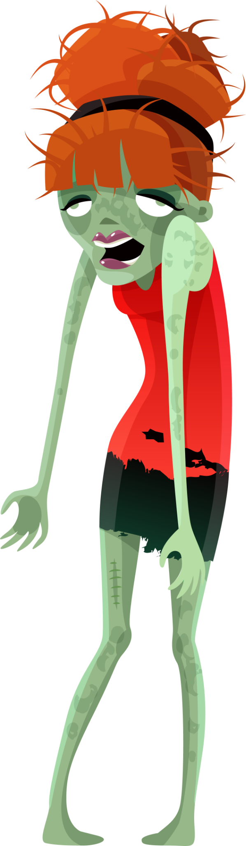
Game Objective:
Protect your house from waves of zombies by planting defensive plants. Survive each wave to win!

Slide 5

How to Play:
pay attention on 2 things
Plants
Place plants strategically to stop zombies
Sun
Collect sunlight to grow plants
Home
sun
Plants
score
level

Slide 6
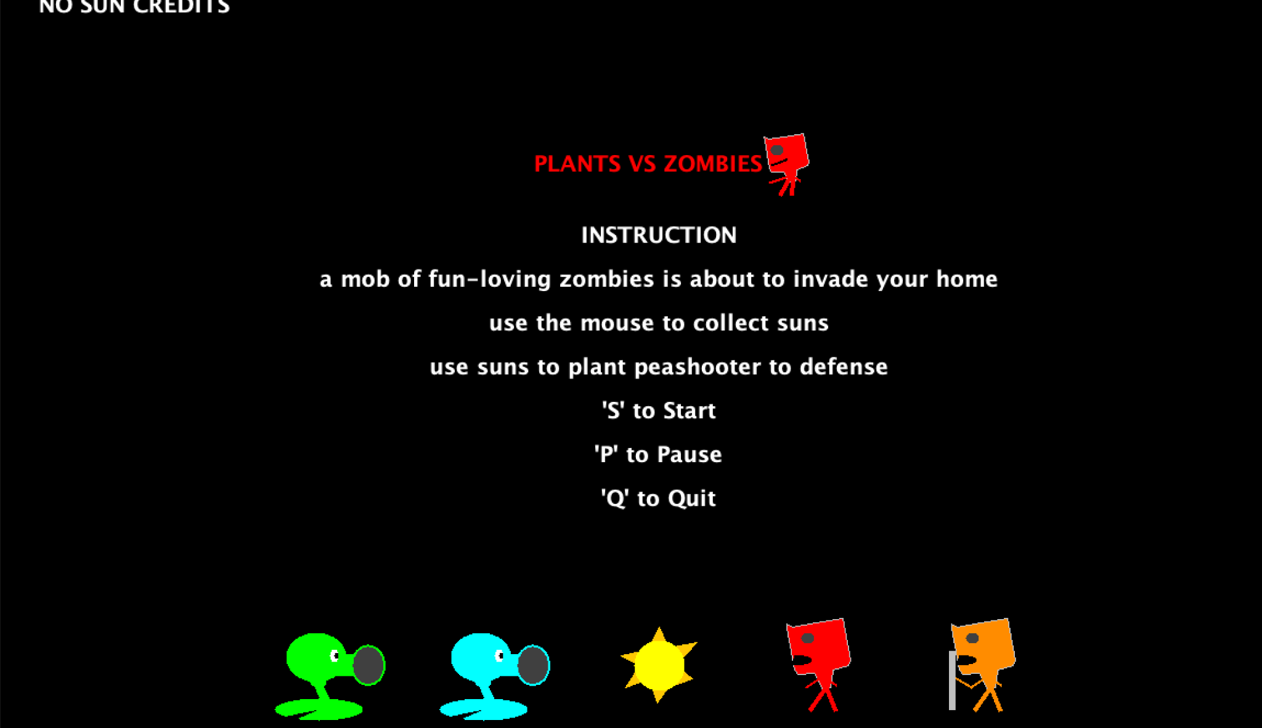
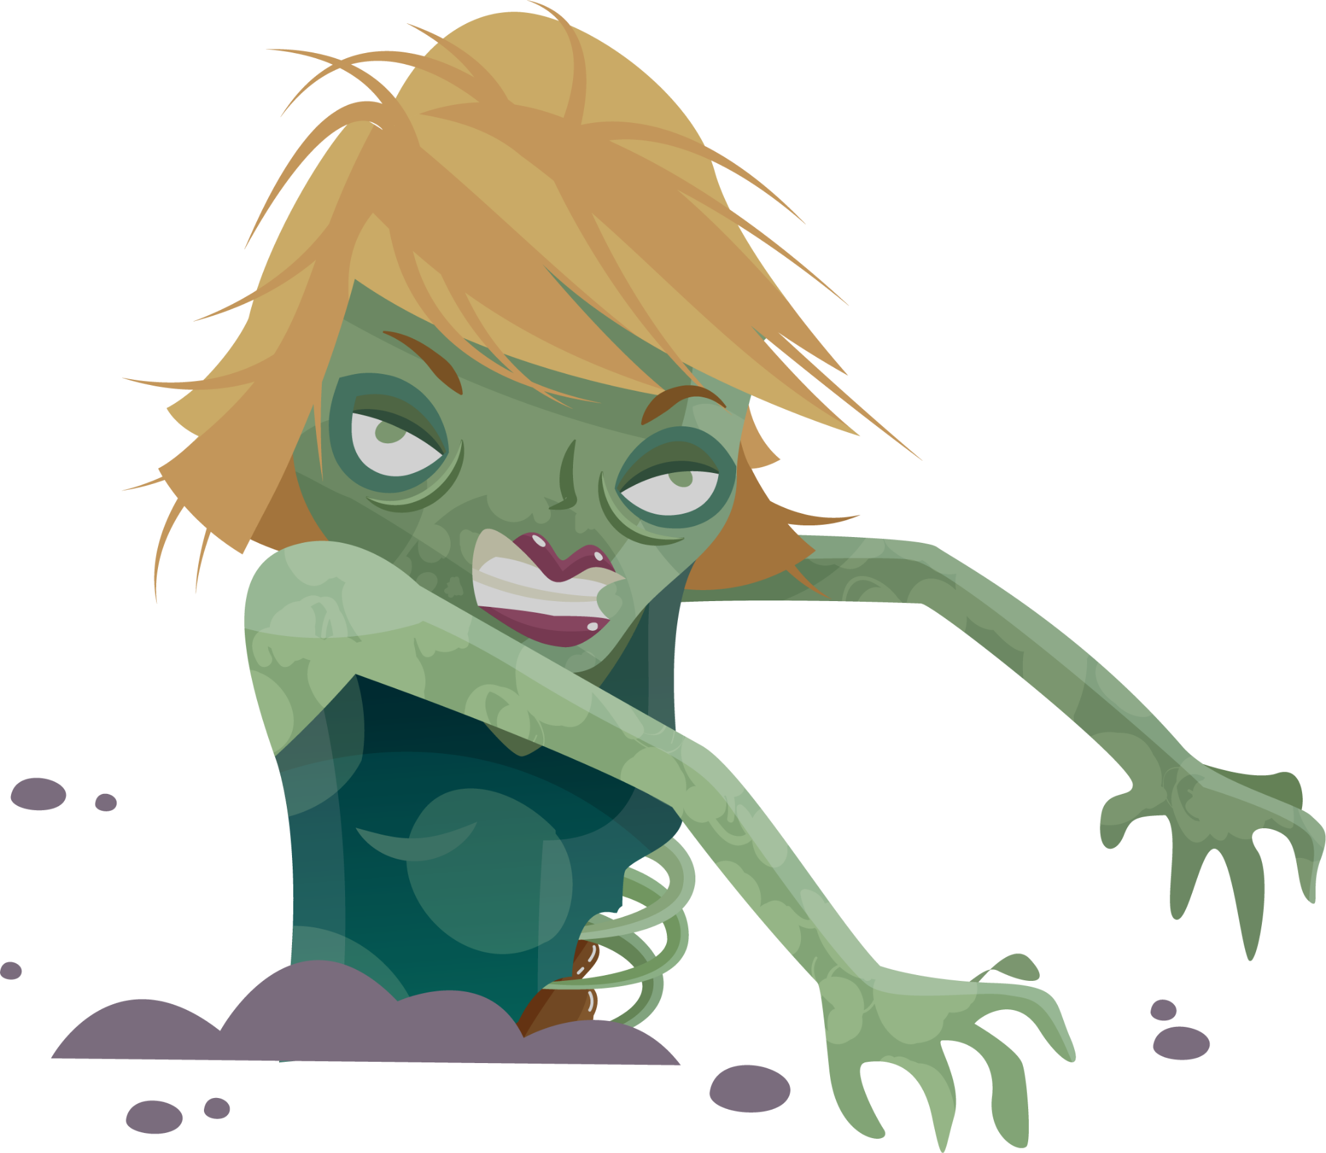
Game
Demo

Slide 7
Swing & awt GUI
Swing is used for building the interactive game interface, rendering dynamic objects like plants, zombies, and suns.
AWT provides foundational tools for handling low-level graphics, such as drawing shapes and colors on the screen.
Implements double buffering to avoid screen flickering, ensuring smooth animations.

Slide 8
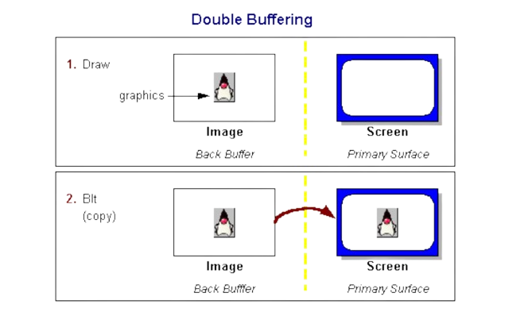
1.Draw to the Back Buffer
2.Copy to the Screen

Slide 9
02
Architecture
And
Design decisions
Xiaowen Zhao

Slide 10
MVC architecture
Controller
Generate sunlight, zombie, shooter;
Check credit, hit and die;
Update game status, zombie moving, plant attack;
Play sound
Display game on screen
Model
View
Render game content:
Sunlight credit, Zombie, Shooter
Notes:
Content:
User actions → Controller → Update game logic in Model.
Model sends updated game state to View.
View renders real-time changes on screen.
Let’s take a closer look.
We let controller deal with everything player will give us, like mouse dragging, and clicking, this will be discussed in details in the next section. Besides the user behaviors, controller is also responsible for making things happen, like hitting zombie, and generating new sunlight and zombie as time passes. The controller complies all of these duties by calling functions defined in the Model.
So, let’s continue to the Model. The main logic is put in this part. we need to Check. we check if player has enough sunlight credit to plant a new peashooter. And If the peashooter actually hitting the zombie? bcs sometimes peashooters are just shooting bullets but not hurting zombie, and zombie will never die. And then, we Update to make every zombie keep moving with the same pace, and peashooter should continuously shooting bullets until they die. The updated game status can be visualized in the View part. This part only for displaying game. It sets the game frame, game panel, and instructions.

Slide 11
Model Design
Movable
WHY ?
abstract
concrete
Sprite
Bullet
Level
Instruction
Exploding
head
Peashooter
Sun
Zombie
Crazy
Zombie
Candidate
Peashooter
Candidate
IcePeashooter
IcePeashooter
Notes:
This is how we designed the Model.

Slide 12
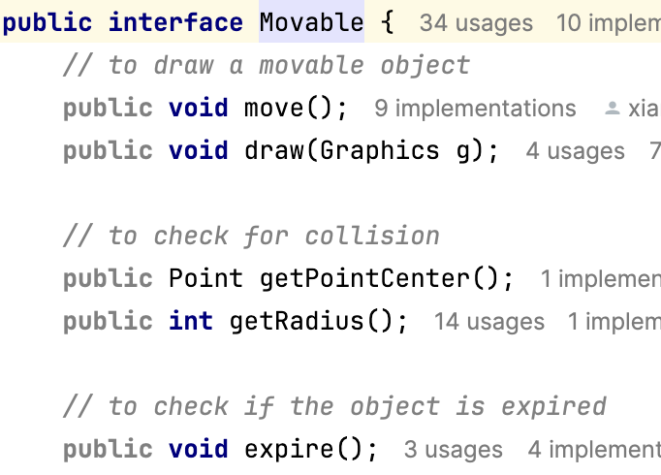
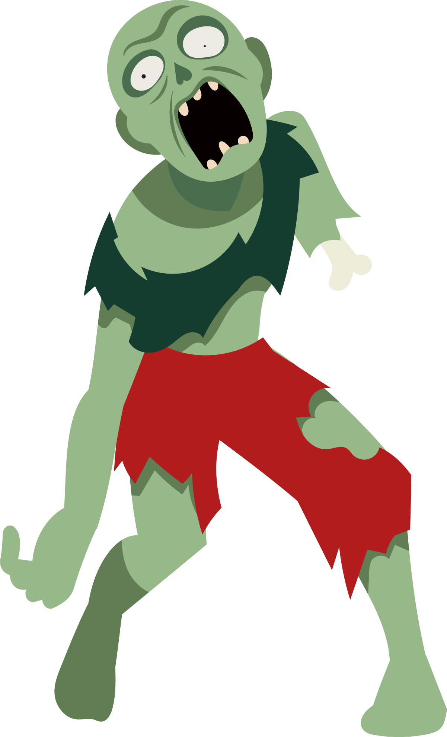
Design Idea
interface
Most of items are moving, such as sunlight, zombie, bullet.
Every item must be displayed as a graph.
An anchor is needed to locate every item.
Need to detect collision between items? — yes
Does zombie live forever? — No, no immortal zombie
Does sunlight last forever? — No, it’s not a diamond
Notes:
We first thought two interfaces should be created: one for plant, one for zombie. But later, we found out these two interfaces can be combine into one for all moving items, no matter this item is a plant or zombie. Because most of items in this game is moving, and an interface carries out all basic moving requirements can do a better job. so , move() and draw() functions are introduced.
Later we think about how do we know if a zombie is attacked by a bullet. So we need the collision box which requires an anchor point to locate the item and the radius to see how close can be count as a valid attack.
After attacking the zombin, will this zombie be killed? And same logic, will a sunlight disappear if not be collected. Therefore, We introduced expire() function to count zombie’s and sunlight’s lifetime.

Slide 13
Interaction Implementation
03
Xiangying Sun

Slide 14
Core Player Actions in Plant vs Zombie
Two primary actions:
Collect Sun to Gain Points: Sun is the only resource in the game. Players collect sun to earn points that will be used for planting peashooters.
Pick Up and Plant Peashooters to Attack Zombies: Players select and place Peashooter on the grid to defend against the incoming zombies.
Strategic sun collection and plant placement are key to surviving waves of zombies.

Slide 15
Mouselistener
What is MouseListener?
An interface in Java used to handle mouse events.
Captures events such as mouse clicks, releases and movements
Why MouseListener:
Mouse enables players to have direct interaction with the objects on the screen.
Provides an intuitive way for players to interact with the game.

Slide 16
Mouselistener
Key MouseListener Methods used:
mouseClicked(MouseEvent e)
mousePressed(MouseEvent e)
mouseReleased(MouseEvent e)
mouseDragged(MouseEvent e)

Slide 17
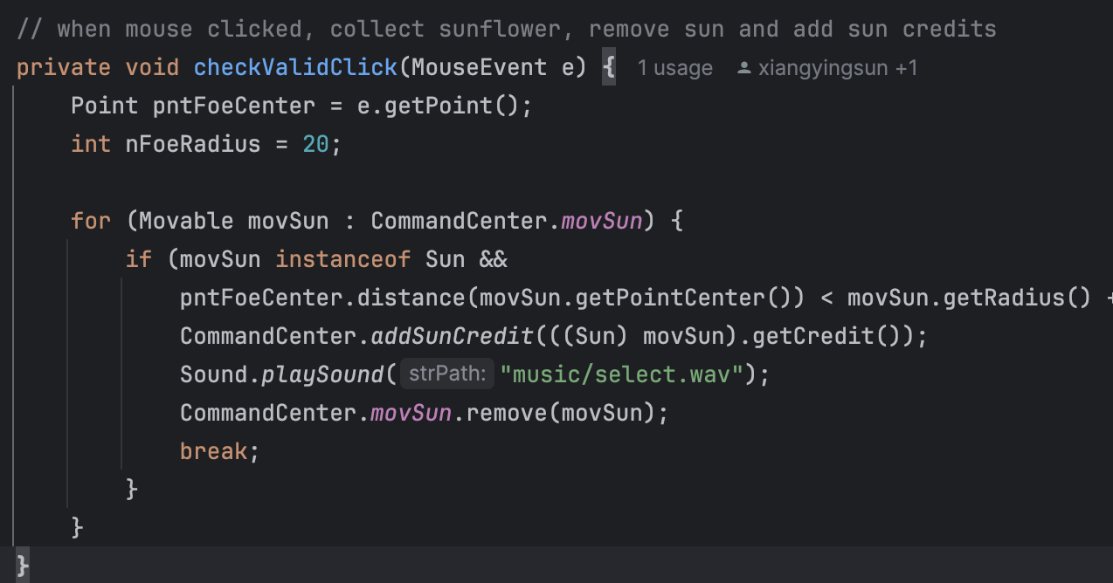
Using MouseListener to Collect Sun
Method used:
mouseClicked(MouseEvent e)
How it works:
When the player clicks on a sun object, the mouseClicked method is triggered.
The game checks if the click coordinates intersect with the sun's position.
If true, the sun is collected, and the player gains resources.

Slide 18
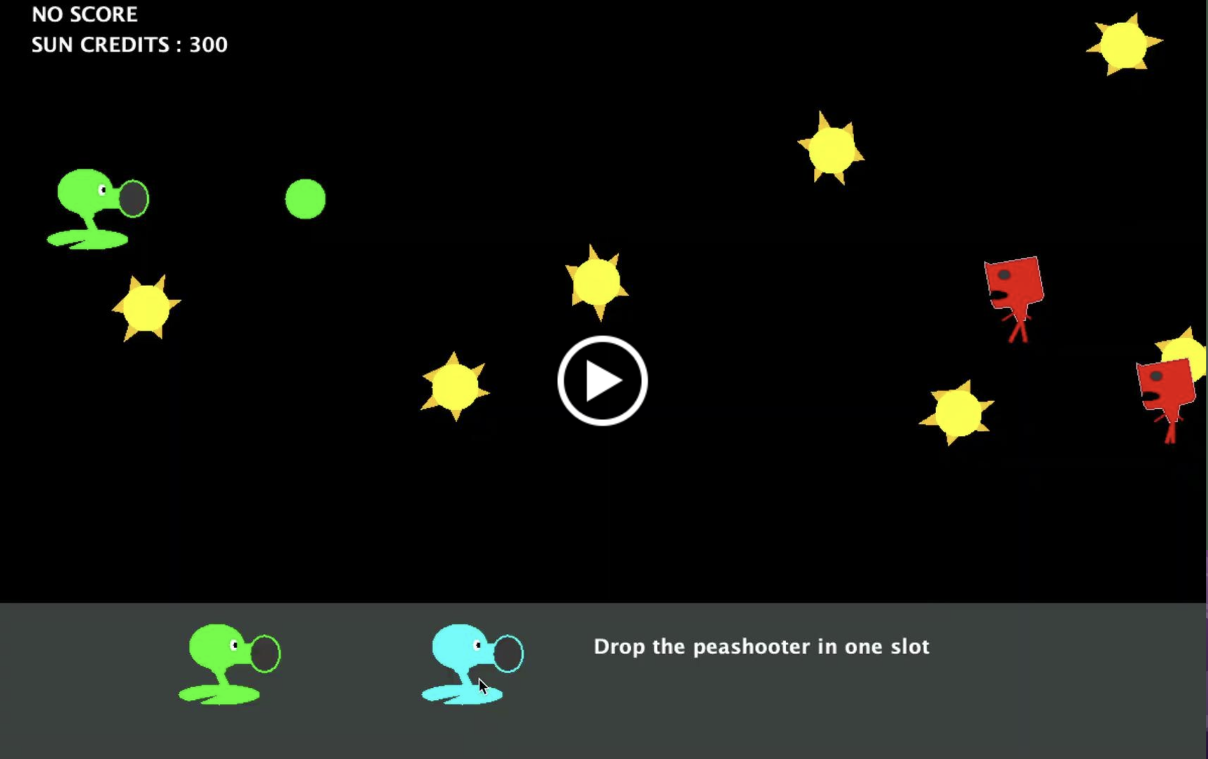
Using MouseListener to Plant peashooters
Method used:
mousePressed(MouseEvent e)
mouseReleased(MouseEvent e)
mouseDragged(MouseEvent e)
How it works:
Players click on the location of a candidate peashooter.
The mousePressed method checks if the clicked area is valid.
Players then dragged the mouse to the grid and release the mouse to plant

Slide 19
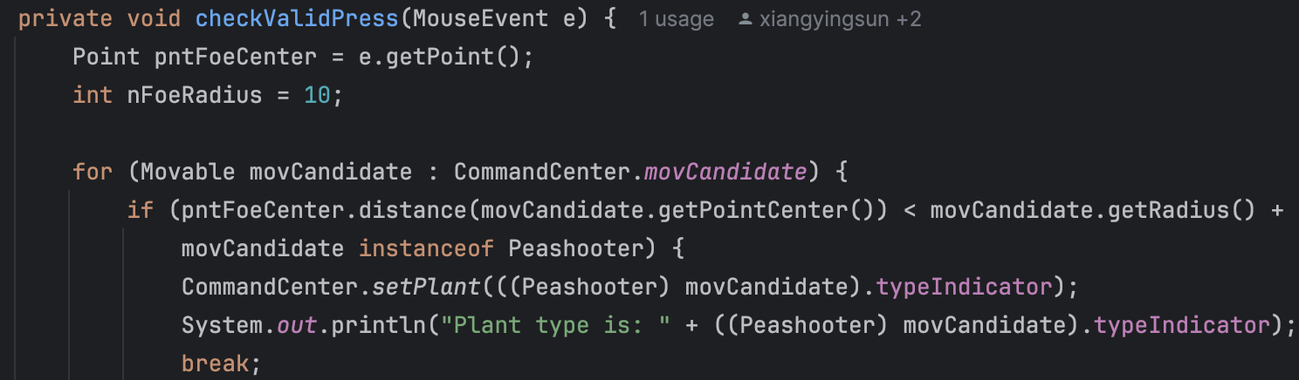
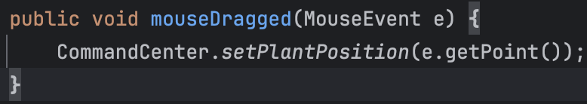
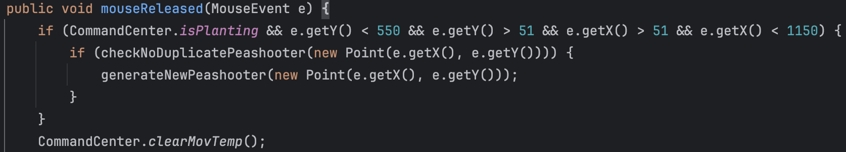

Slide 20
Contribution & conclusion
Question:
Can pressing the mouse trigger MouseClick() method?
Home
Game
Tools
Facts
Team

Slide 21
Conclusions
We built a dynamic Plants vs Zombies game using Java, focusing on key gameplay elements such as collecting sun and planting Peashooters.
The project demonstrates the use of classes, inheritance, and interfaces to create a modular MVC-based game structure.
To manage multiple game elements and interactions, we defined the game’s logic clearly and leveraged the use of classes and superclasses to reduce complexity.
Have an enhanced tutorial
Adjust game difficulty
Things we learn from this project:
Building a Game is Challenging
The Importance of Music
Things we need to improve:
Have an enhanced tutorial and adjust game difficulty
Notes:
Building a Game is Challenging: Game development requires significant effort in testing, tuning, and balancing to create a smooth and enjoyable experience.
The Importance of Music: Music and sound effects are crucial to enhancing the overall gaming experience and engagement.
Enhanced Tutorial: Add more details to the tutorial to better guide new players through the game mechanics.
Game Difficulty: Fine-tune the difficulty level to ensure the game is challenging yet enjoyable, avoiding it being too easy or frustrating.

Slide 22
Contribution & conclusion
Conclusion
Smooth animations, intuitive controls, and creative gameplay.
Future improvements: smarter zombie and better performance for complex levels.
Contribution
Double buffering for smooth visuals.
Seamless mouse and keyboard interactions.
Unique features like Crazy Zombie and freeze effects.
Home
Game
Tools
Facts
Team

Slide 23
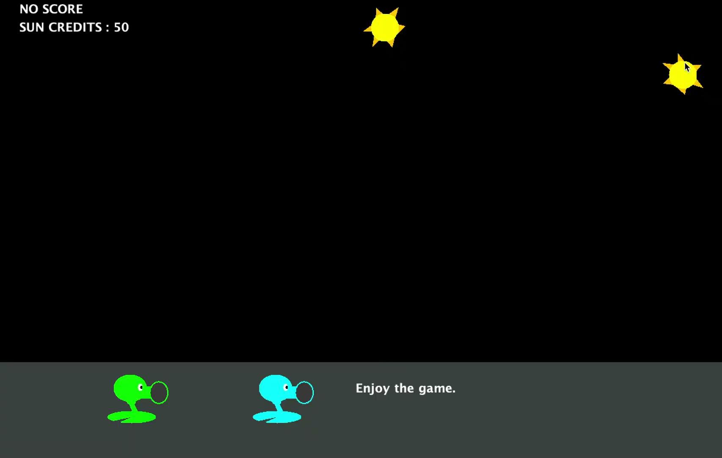
Valid click

Slide 24
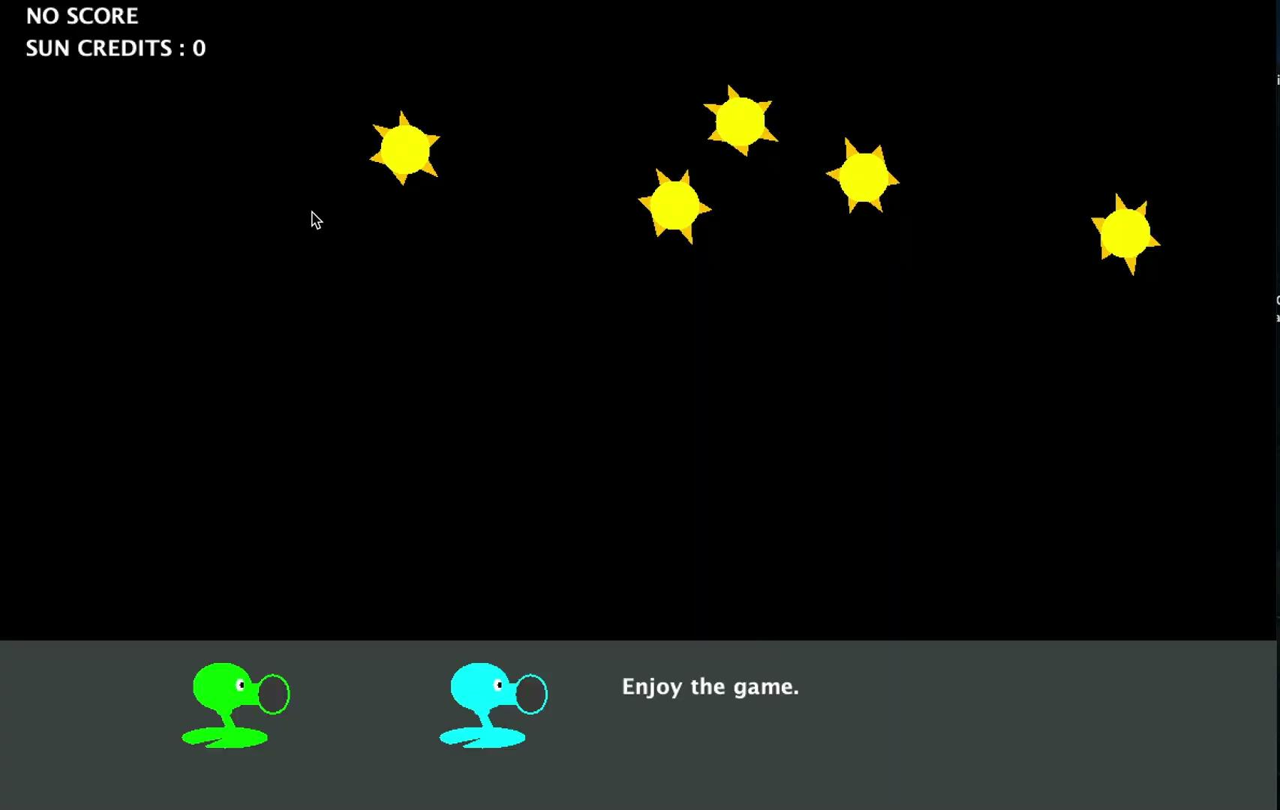
invalid click

Slide 25
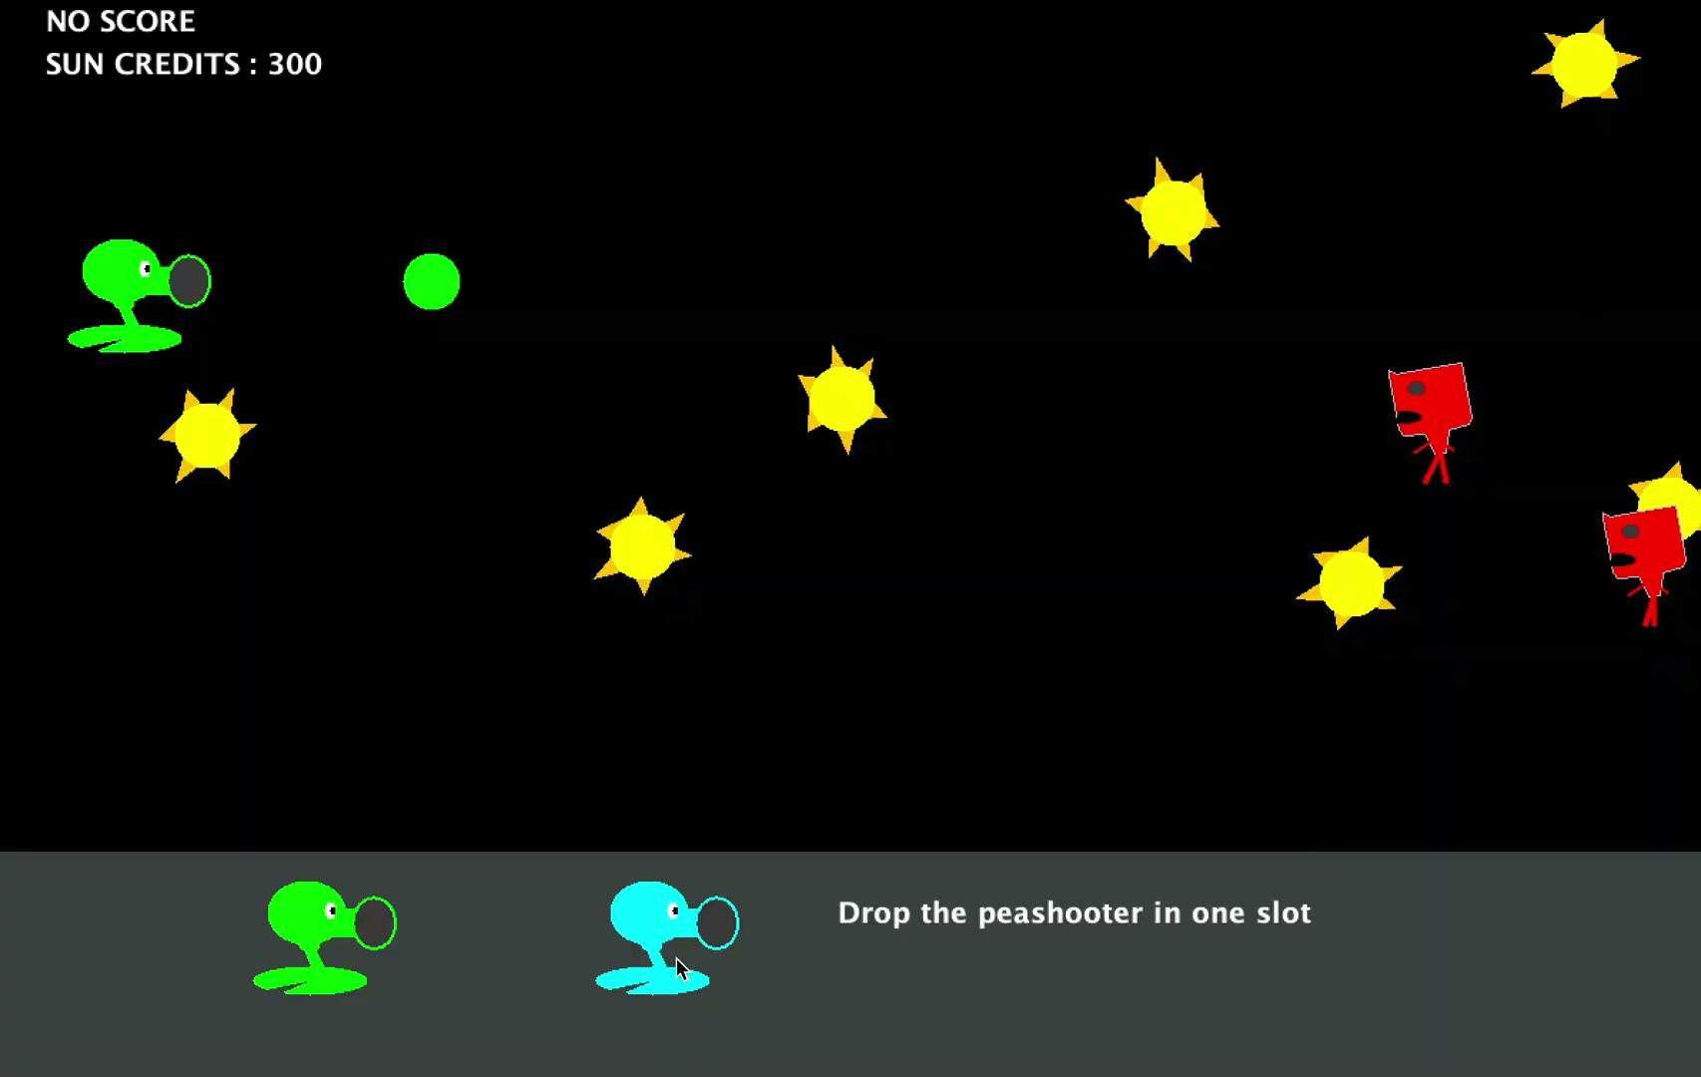
Valid planting

Slide 26
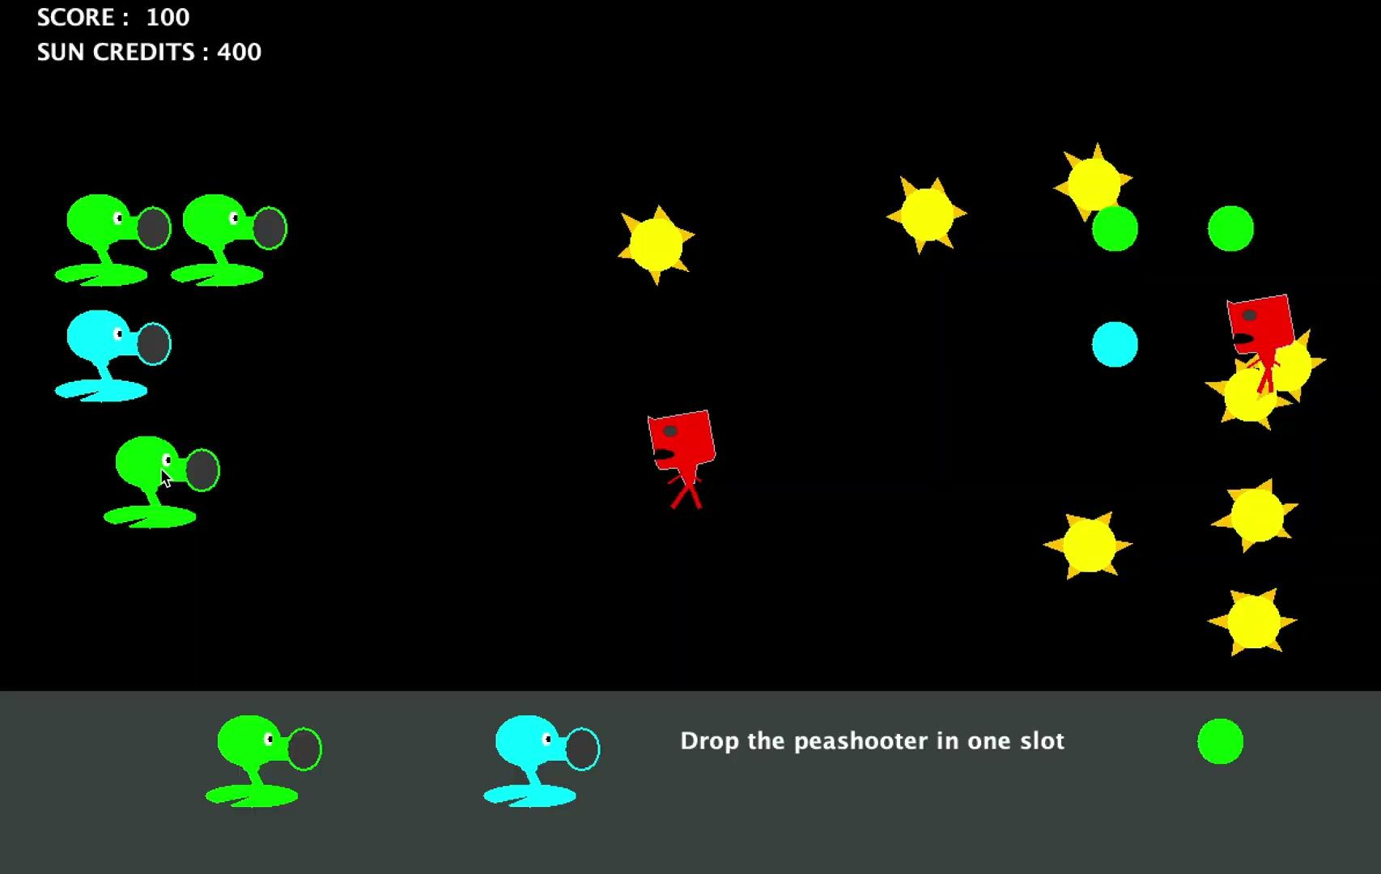
invalid planting

